Slide 1
Traffic Crashes
2021
Done by: Jibreel Mohamed
Sajal Chandra

Slide 2
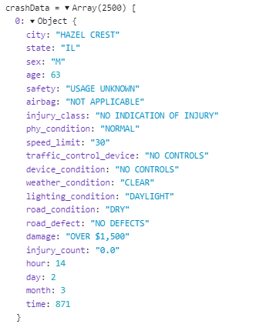
DATASET
Taken from Chicago Data Portal
Merged Traffic Crash Dataset with People involved dataset
Analysed only 2021 data
Sampled the data to 2500 random points to avoid overplotting

Slide 3
Our Questions
Domain Questions
How does weather/season affect traffic crashes?
Data Questions
Which age groups are most likely to be in a car crash?
What is the distribution of features like weather conditions during summers vs winters?
What are the frequencies of the types of injuries suffered in summers vs winters?
Do seasons or months affect the total number of crashes?

Slide 4
Hypotheses
People in their prime tend to have more crashes
There are more crashes in summer than winter
Bad driving conditions lead to more crashes

Slide 5
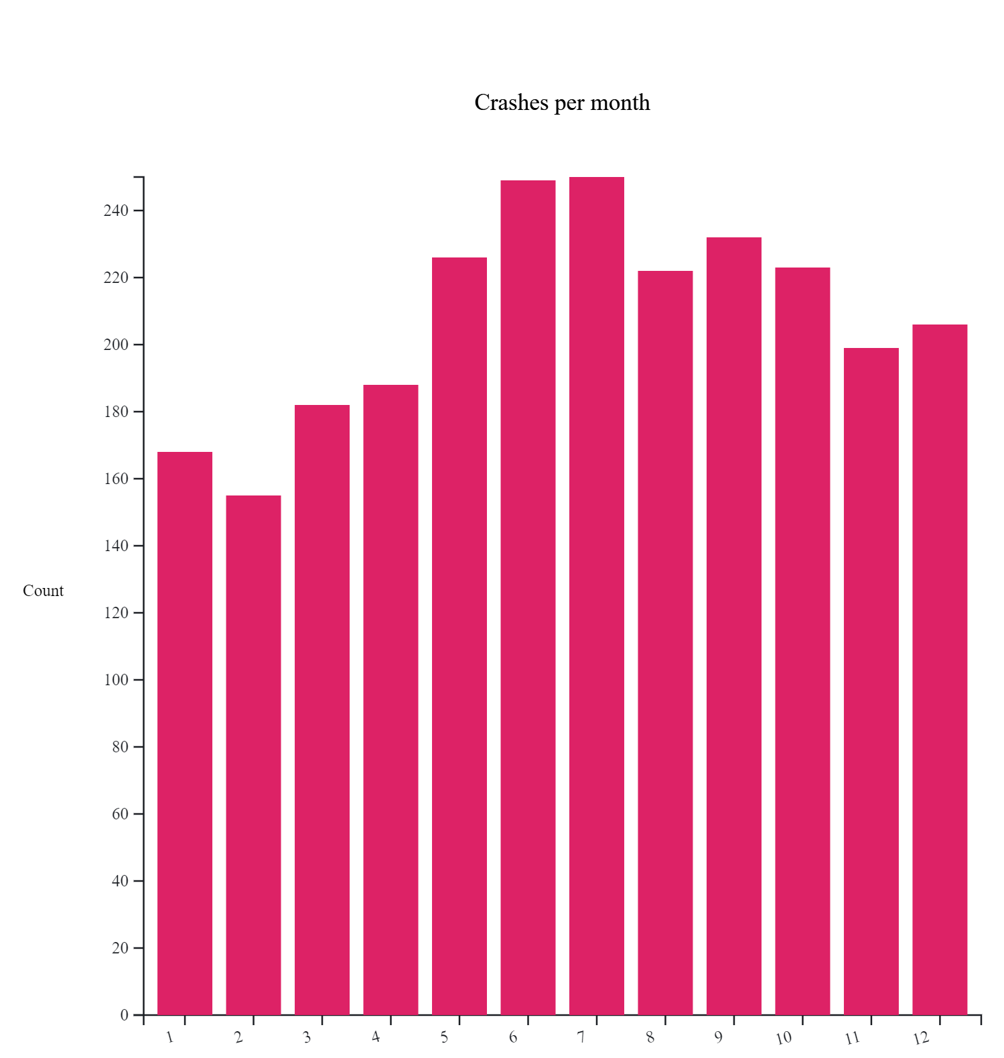
Which months do crashes occur the most?
Month

Slide 6
Crash counts:
Summers v/s Winters

Slide 7


Slide 8
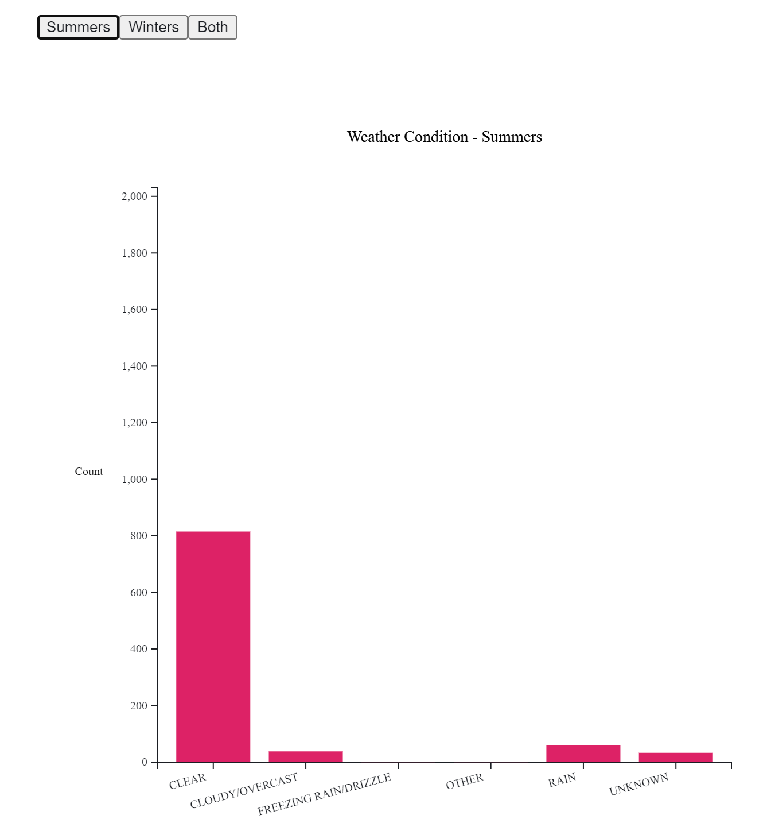
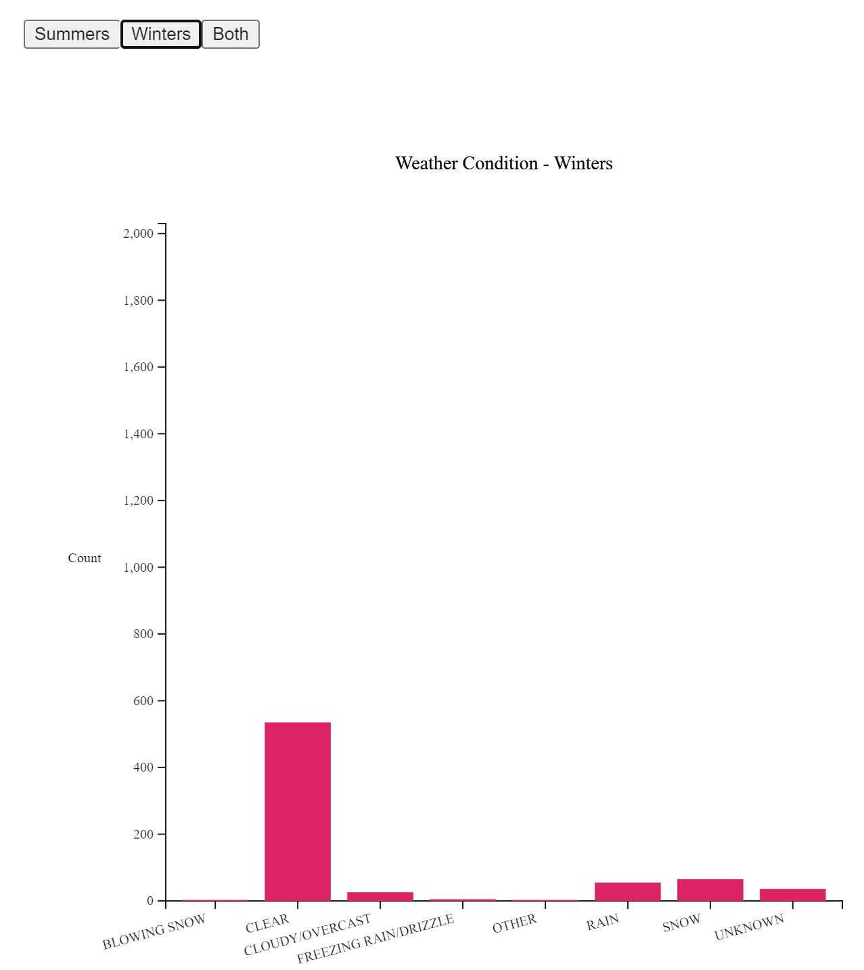

Slide 9
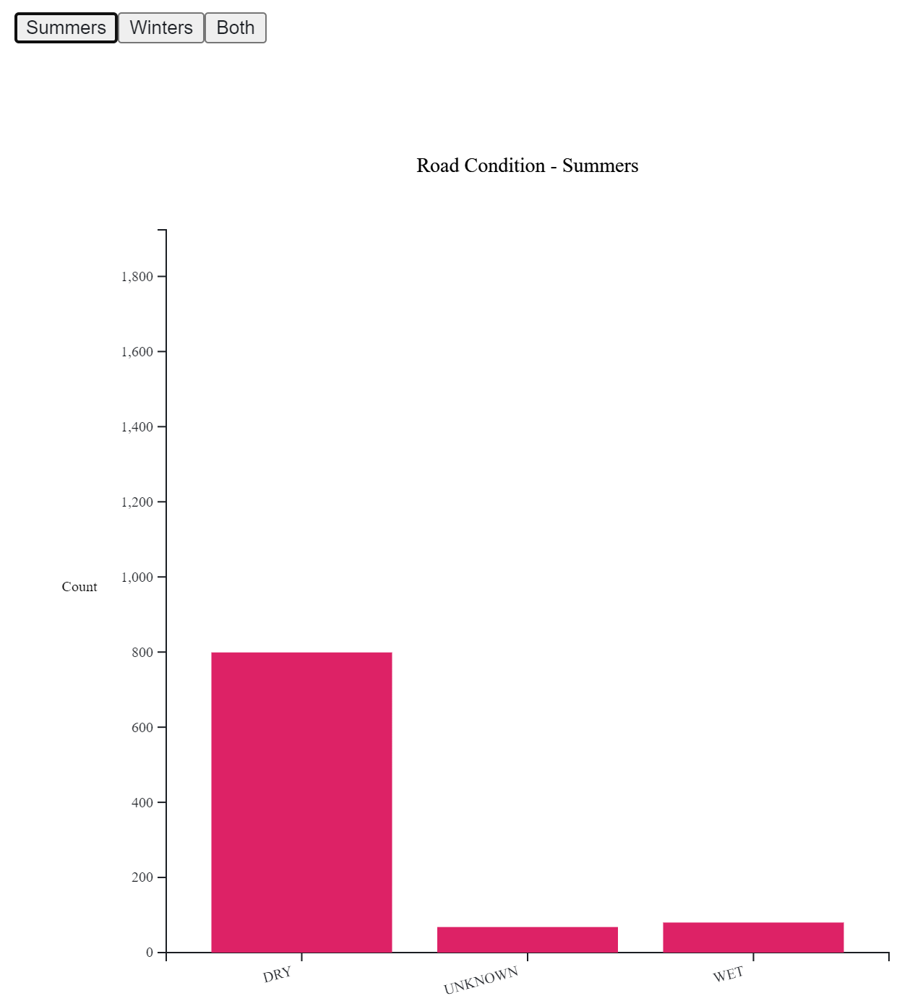
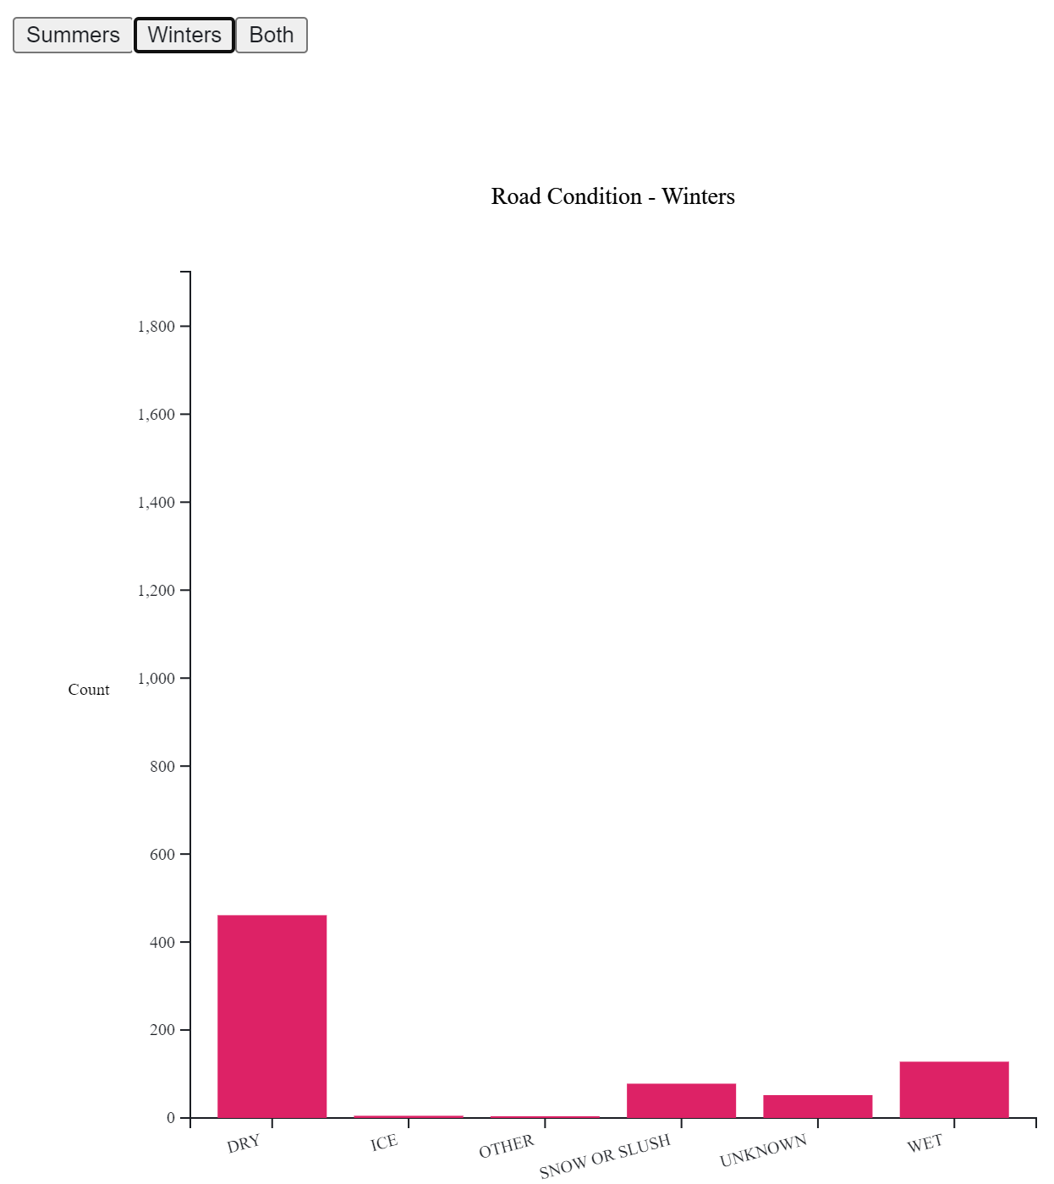

Slide 10
Age demographics and impact on injury severity, cost of damages, and number of injuries

Slide 12
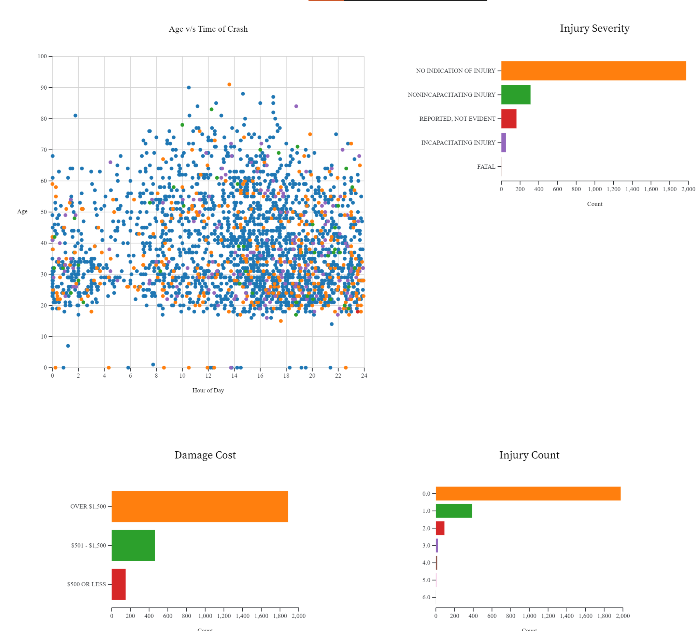
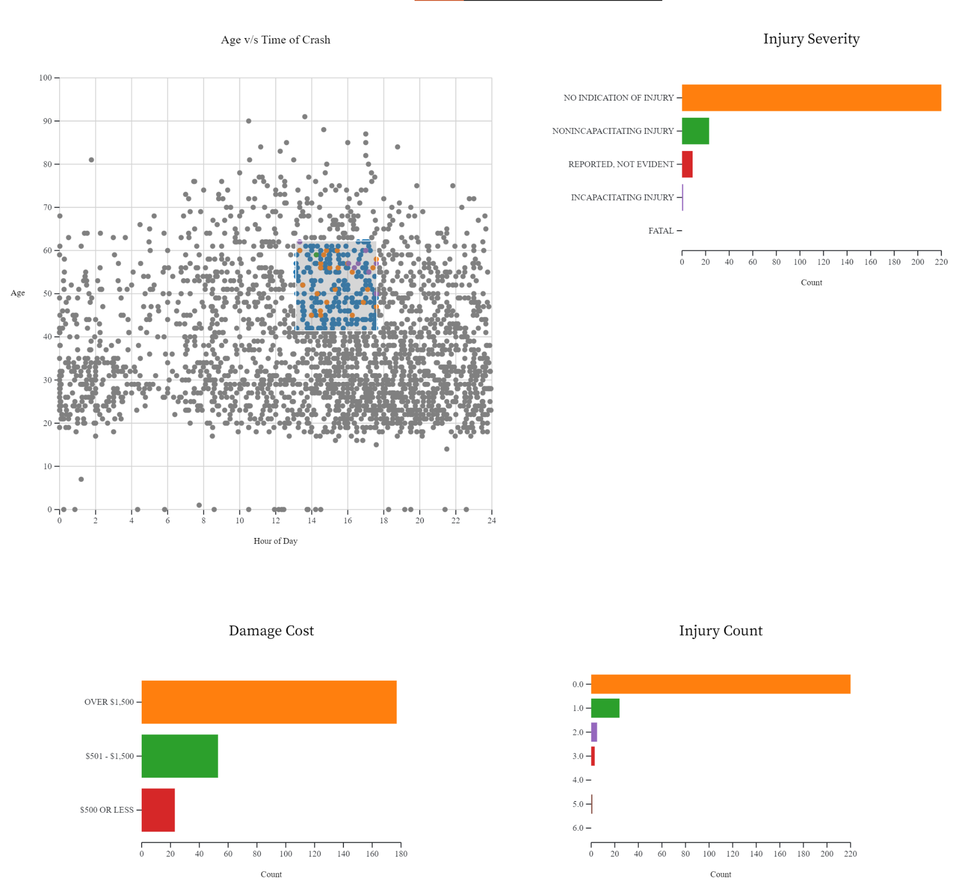

Slide 13
Revisiting our Hypotheses
People in their prime tend to have more crashes - CORRECT
There are more crashes in summer than winter - CORRECT
Bad driving conditions lead to more crashes - INCORRECT

Slide 14
Thank you

